Slide 1
JPX Tokyo Stock Exchange Prediction: Tokyo Gas Study Case
This project was built by a team of four persons including Azizha Zeinita

Slide 2
Background
Japan Exchange Group, Inc. (JPX) is a holding company operating one of the largest stock exchanges in the world, which one of it’s significant stocks is Tokyo Gas stock.
This project will compare several models against real future returns of Tokyo Gas stock after the training phase is complete.
Other external datasets that are closely related to stock price, such as Japan GDP, Unemployment Rate, Oil Price, etc., will also involved in different combinations to find the best output.

Slide 3
Agenda
Business case and problem statement
Data description and properties
Data processing and EDA
Arima Models
Var Models
Prophet / LSTM Models
Insights/Recommendations & Future work

Slide 4


Business Case and Research Purpose
Select the best performance model that will be used for building the stock portfolio in the future and try to rank four energy stocks based on the future return.
Compared multivariate models with univariate models to determine which model produce higher accuracy score for stock price prediction.

Slide 5
Data Description and Properties
Stock Data:
Secondary Stock Price: Daily closing price for each stocks (The Core)
Stock List: Company names and industry the company is in. (EDA)
Alternative Data (Multivariate Models):
Japan Seasonally Adjusted Gross Domestic Product (GDP)
Japan Seasonally Adjusted Unemployment Rate
Daily Crude Oil Price
Daily Exchange Rate for USD JPY
Japan Daily 10 year Treasury Bond Interest Rate
Nikkei 225 index

Slide 6
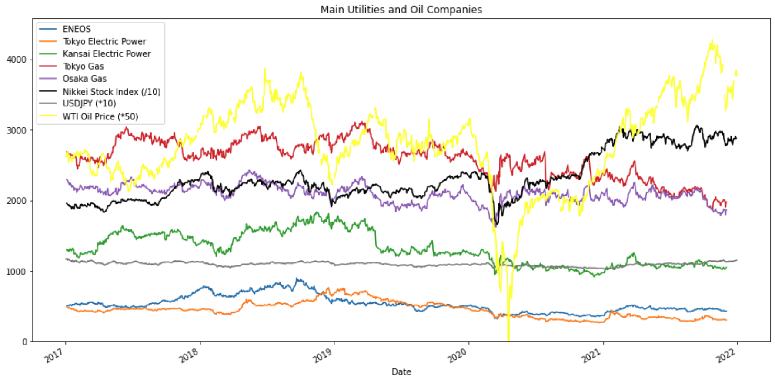
Exploratory Data Analysis
Stocks are divided into 33 major sectors. Energy sector only has 38 companies.
According to the Random Walk Theory, stock price are entirely random and there is no seasonality or trend.
The trend of oil companies stock price is similar to the trend of the global oil price and the Nikkei 225 Index. In addition, oil companies stocks price are correlated with each other

Slide 7
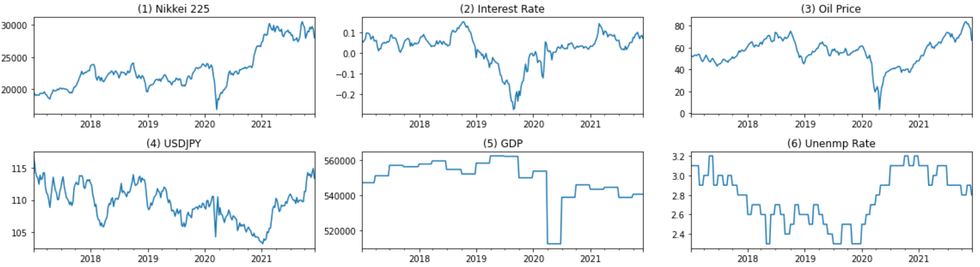
Feature Engineering: External Regressors
Prepare 6 external regressors that are closely related to stock prices.
(1) Nikkei 225 Index(Daily) * Equivalent to S&P500 (2) Long-term Interest Rate(Daily) *For 10-year Treasury Bond
(3) Crude Oil Price(Daily) *West Texas Intermediate (WTI) (4) Exchange Rate(Daily) *Yen/USD
(5) GDP(Quarterly) *Nominal GDP (6) Unemployment Rate(Monthly) *For Aged 15-64

Slide 8
Models
ARIMA, VAR, PROPHET, LSTM

Slide 9
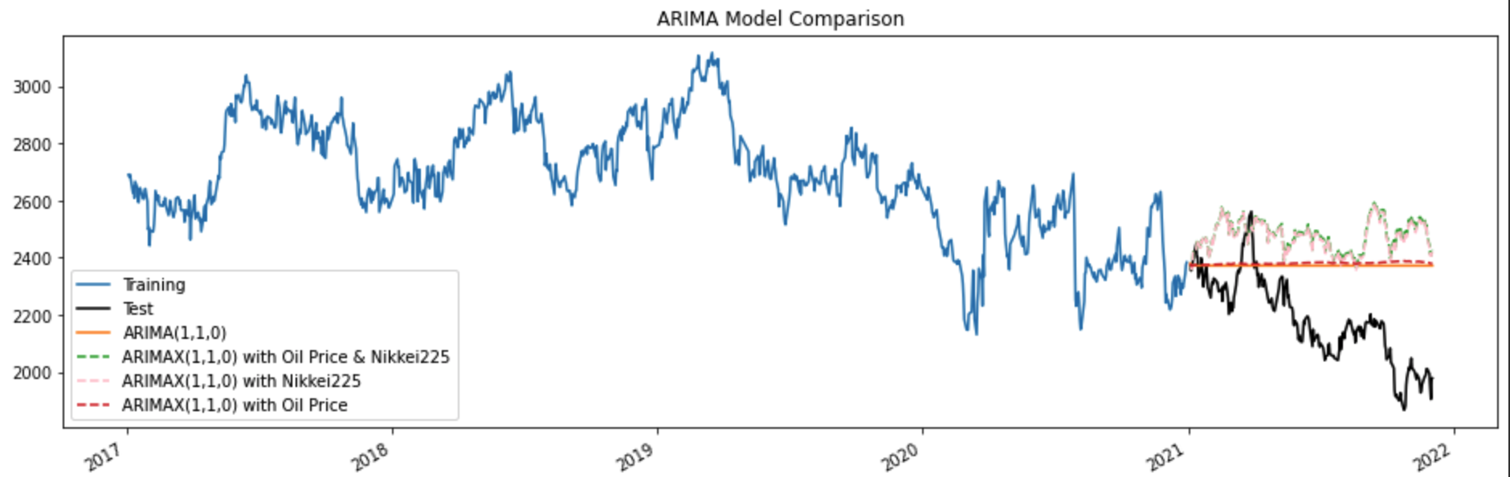
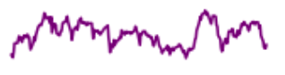
ARIMA Model Daily
N225 Index
All ARIMA models performed poorly on predicting the price
Univariate ARIMA does generate meaningful outcome
Multivariate ARIMA captured too much trend of N225 index
 | MAE | MSE | MAPE | sMAPE | MASE
Univariate | 203.792 | 58725.1 | 0.0978 | 0.0914 | -8.7564
Oil | 211.5135 | 63002.5703 | 0.1015 | 0.0946 | -9.0882
N225 | 292.0734 | 107173.8052 | 0.1389 | 0.1274 | -12.5497
Oil, N225 | 298.0109 | 111508.5736 | 0.1417 | 0.1298 | -12.8048

Slide 10
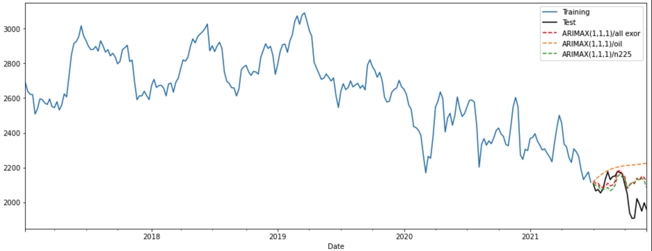
ARIMA Model Weekly
Shorten the prediction time and using weekly mean helps to improve ARIMA accuracy
Univariate ARIMA does generate meaningful outcome
Multivariate ARIMA captured too much trend of N225 index
The worst
 | MAE | MSE | MAPE | sMAPE | MASE
Univariate | 131.9129 | 28228.7658 | 0.0661 | 0.0627 | -1.1125
Oil | 129.9804 | 27404.4503 | 0.0652 | 0.0618 | -1.0962
N225 | 78.5779 | 10447.2298 | 0.0393 | 0.0382 | -0.6627
All | 77.2154 | 10671.9102 | 0.0388 | 0.0375 | -0.6512
The best

Slide 11
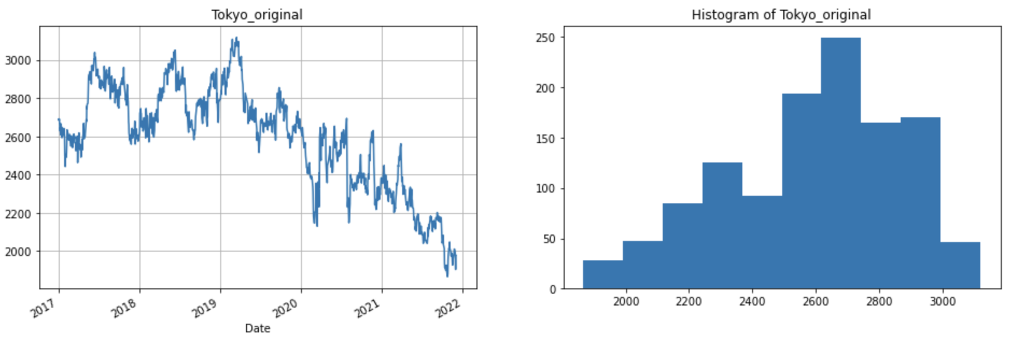
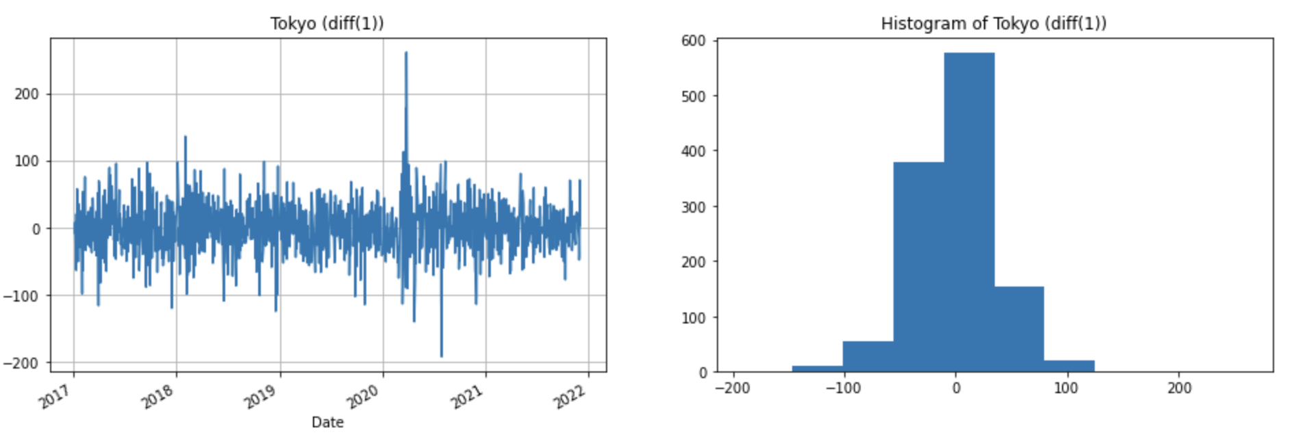
VAR Model
Many real-world forecasting problems have more than one variable to consider.
Vector ARIMA models can help model multivariate time series where:
The variables are serially correlated
The variables are cross-correlated
VAR in levels – using stationary data
VAR in differences – using differenced data
We use 6 different external variables:
Oil, N225, Unemploy, GDP, USD-JPY, interest

Slide 12
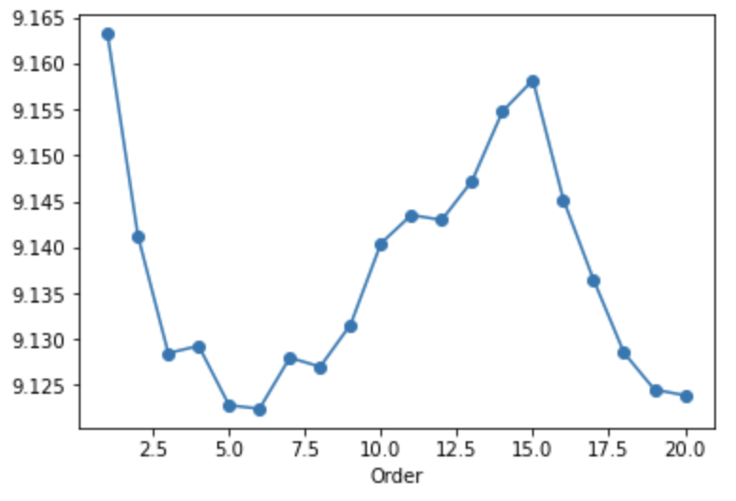
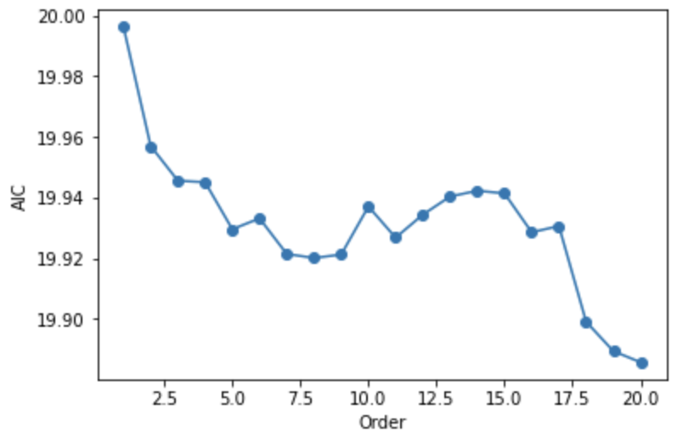
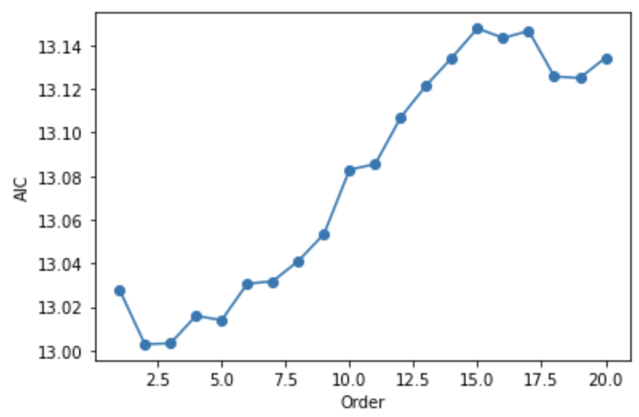
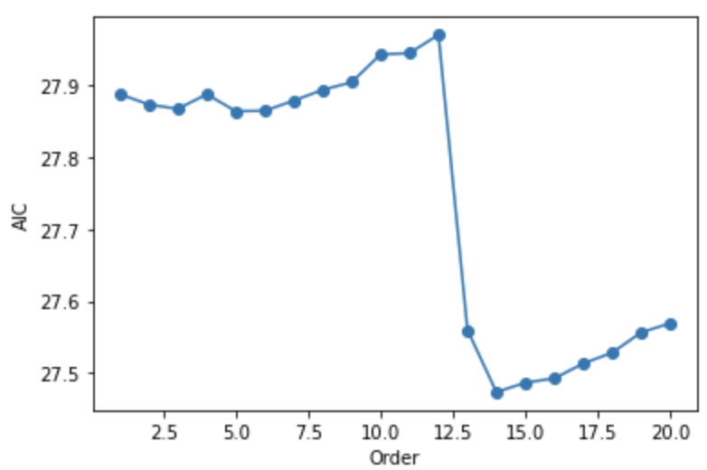
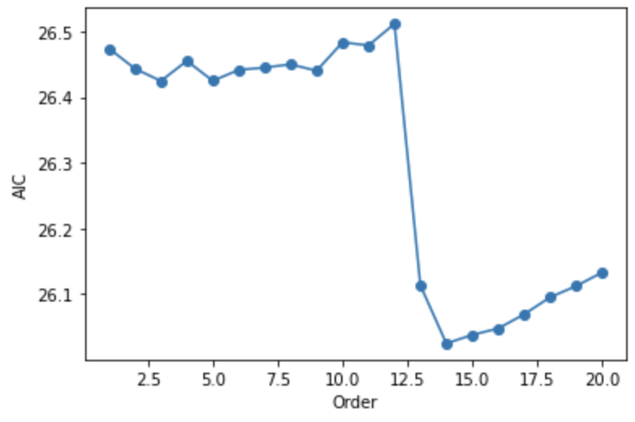
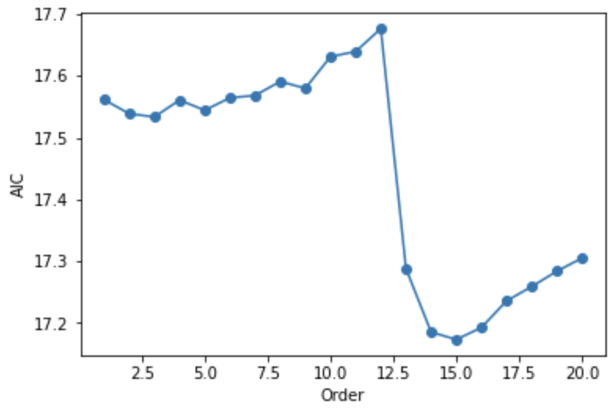
VAR Model
AIC Graphs Comparison
Range of the lowest AIC: 2 - 20
The best model: VAR(15)
The worst model: VAR (2)
1 other var: 6
2 other vars: 20
3 other vars: 2
4 other vars: 14
5 other vars: 14
6 other vars: 15

Slide 13
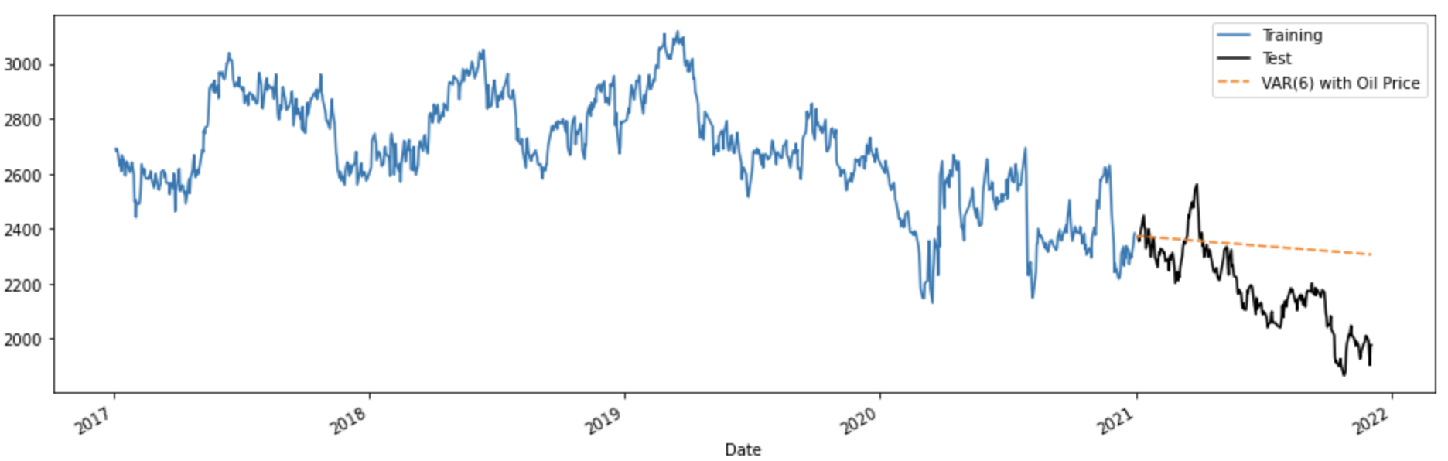
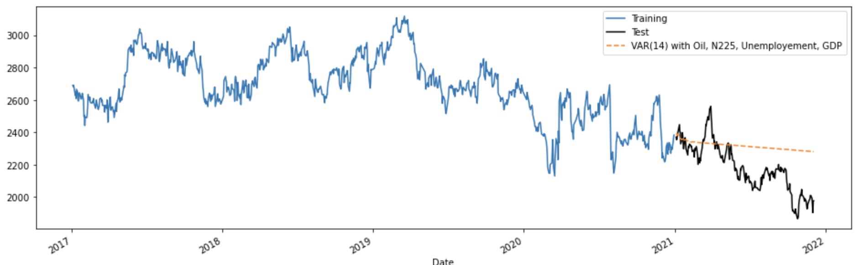
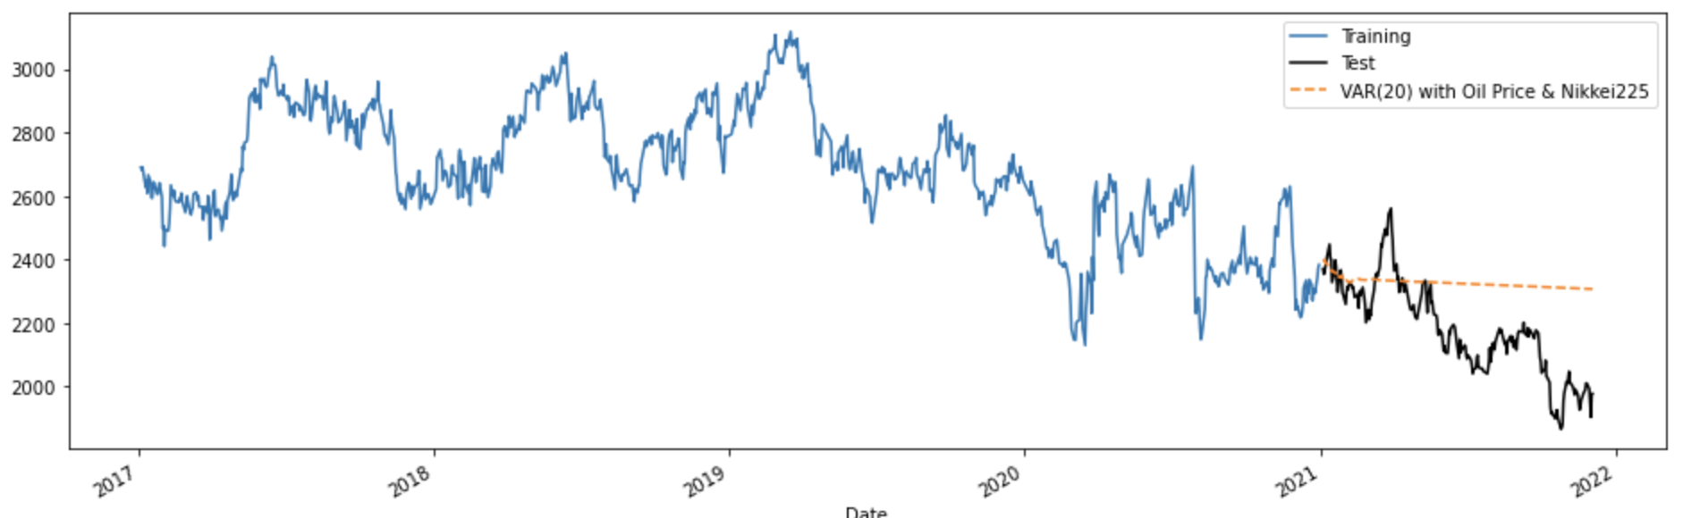
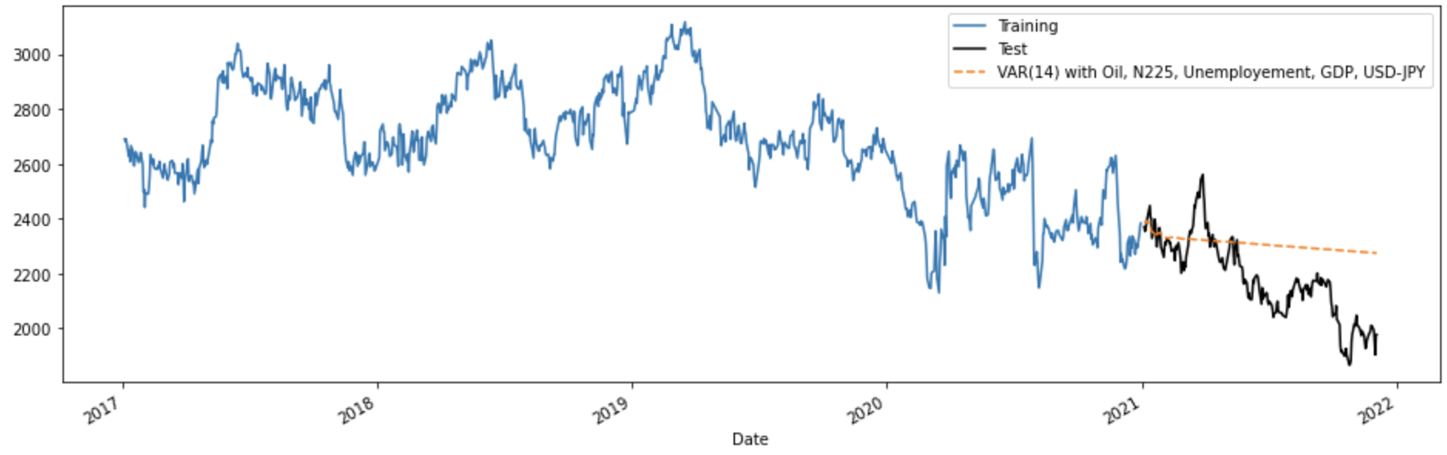
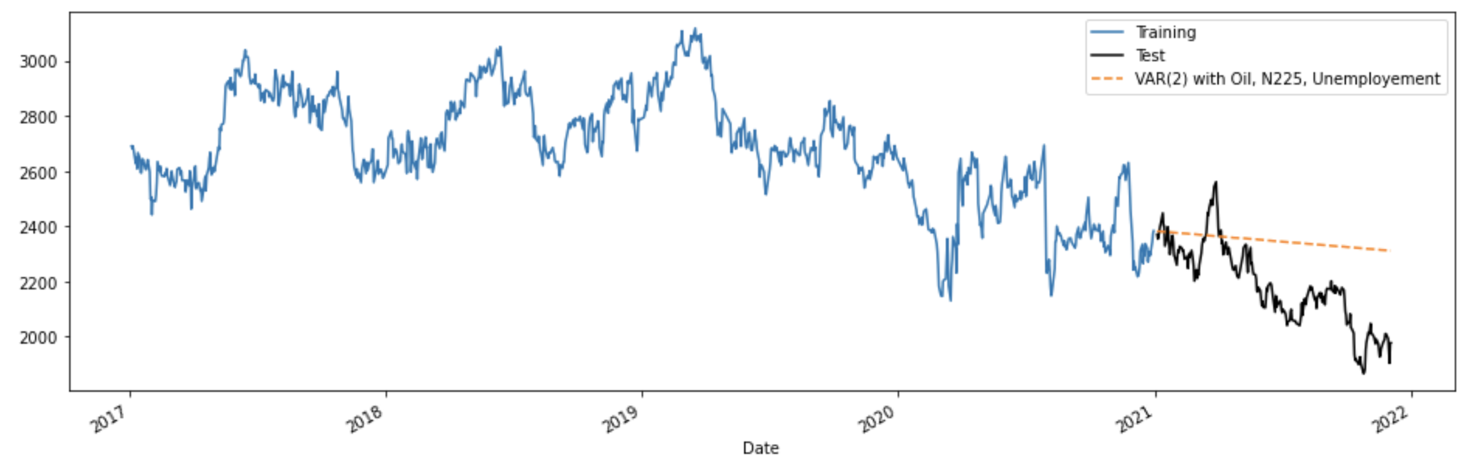
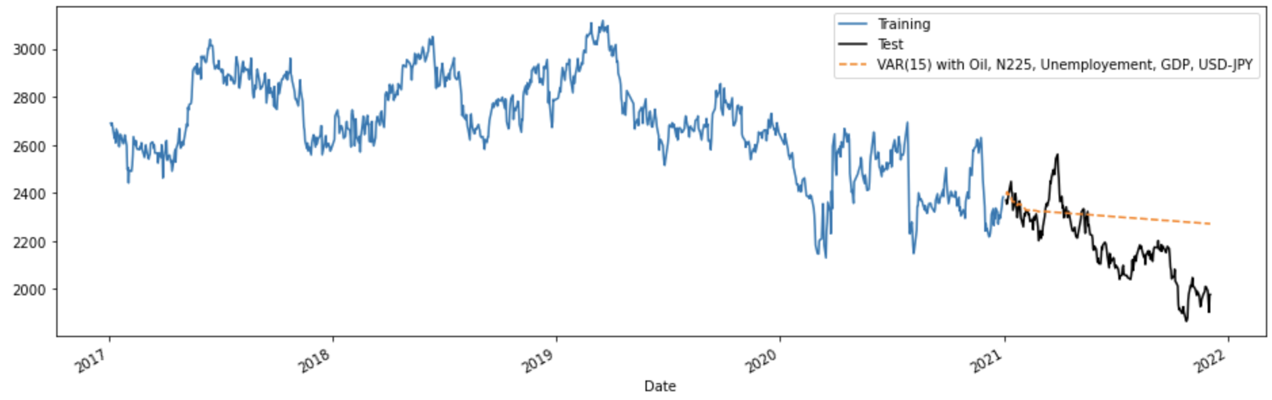
VAR Model
Forecasting Model Graphs Comparison
All predictions are visually almost similar
Even the worst (3 ex. var) and the best (6 ex. var) are slightly different
Closer at the beginning, further away in the ⅔ of the pred. period.
1 other var
4 other vars
2 other vars
5 other vars
3 other vars
6 other vars

Slide 14
VAR Model
Test Error Metrics
The worst
The best
 | MAE | MSE | MAPE | sMAPE | MASE
Oil | 173.6549 | 42873.2797 | 0.0833 | 0.0786 | -7.4615
Oil, N225 | 164.9285 | 40503.7034 | 0.0793 | 0.0749 | -7.0866
Oil, N225, Unemploy | 179.2476 | 44981.3307 | 0.0859 | 0.081 | -7.7018
Oil, N225, Unemploy, GDP | 155.0108 | 35544.422 | 0.0744 | 0.0706 | -6.6604
Oil, N225, Unemploy, GDP, USD-JPY | 149.9029 | 33680.3447 | 0.072 | 0.0684 | -6.441
Oil, N225, Unemploy, GDP, USD-JPY, interest | 148.0882 | 32951.911 | 0.0711 | 0.0676 | -6.363

Slide 15
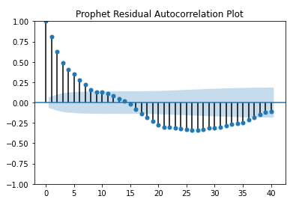
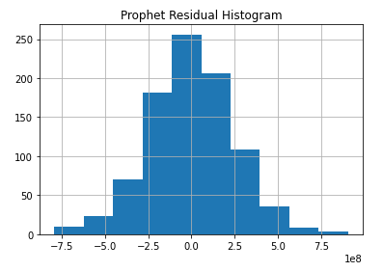
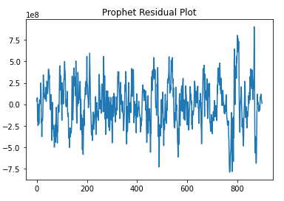
Prophet Model
Univariate Analysis
An additive model where linear or non-linear trends are fit to the data with seasonality.
Model Fitting
Trained the model by using hyperparameter-tuning
changepoint_prior_scale=0.5
seasonality_prior_scale=0.01
Residual Checks:
Prophet TRAIN MAE: 48.20
Prophet TRAIN MSE: 4135.62
Prophet TRAIN MAPE: 0.02
Prophet TRAIN SMAPE: 0.02

Slide 16
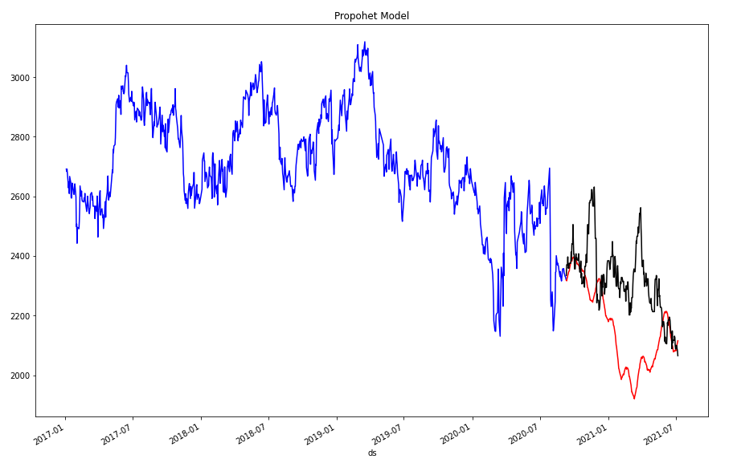
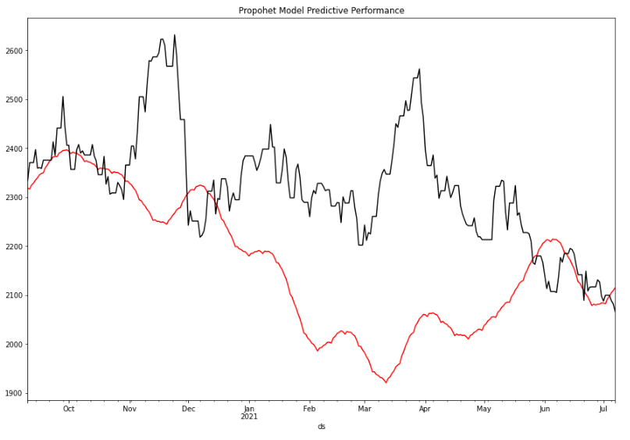
Prophet Model
Predictive Accuracy (Forecasting Period: 09/10/2020 - 12/03/2021):
Prophet TEST MAE: 174.70
Prophet TEST MSE: 49763.55
Prophet TEST MAPE: 0.07
Prophet TEST SMAPE: 0.08

Slide 17
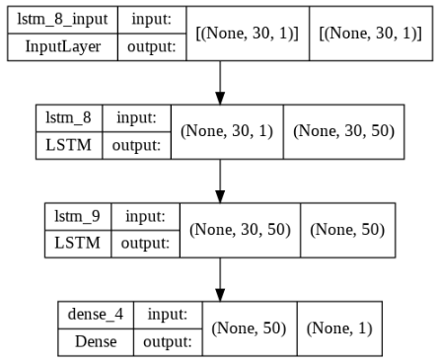
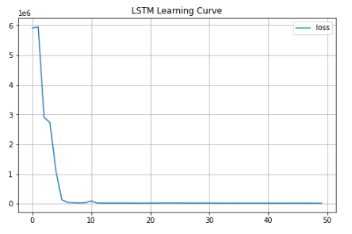
Long Short-Term Memory (LSTM)
Univariate Analysis
The network can learn what to store in the long-term state, what to throw away, and what to read from it.
Model Fitting:

Slide 18
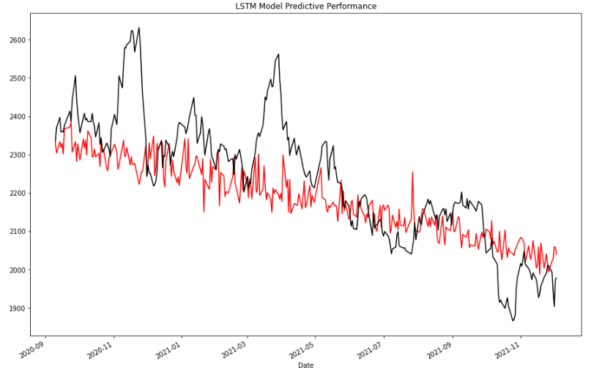
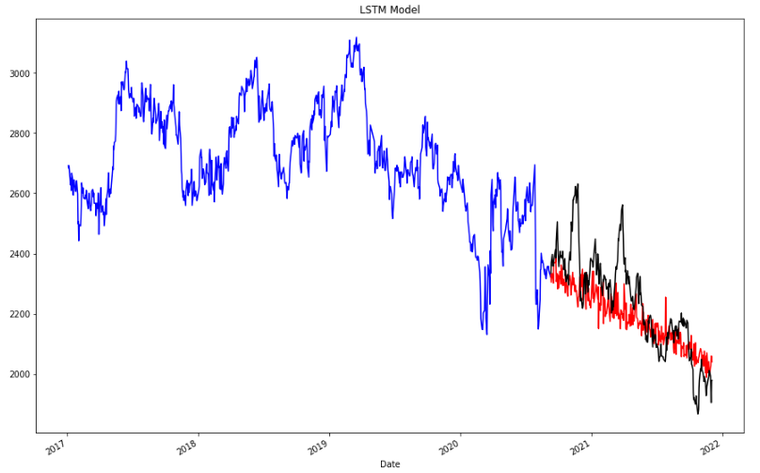
Long Short-Term Memory (LSTM)
Predictive Accuracy (Forecasting Period: 09/10/2020 - 12/03/2021):
LSTM TEST MAE: 88.87
LSTM TEST MSE: 14273.59
LSTM TEST MAPE: 0.04
LSTM TEST SMAPE: 0.04

Slide 19
Conclusion & Insights

Slide 20
Model Comparison
The worst
The best
 | MAE | MSE | MAPE | SMAPE
ARIMA (Univariate) | 203.792 | 58725.1 | 0.10 | 0.09
VARIMA (Oil, N225, Unemploy, GDP, USD-JPY, interest) | 148.09 | 32951.91 | 0.07 | 0.07
Prophet | 174.70 | 49763.55 | 0.07 | 0.08
LSTM | 88.87 | 14273.59 | 0.04 | 0.04

Slide 21
Insights and Future Work
Predictive accuracy is high in the short-term. In the long-term, the predictions are less accurate.
Build models for all 2000 stocks and analyze the performance.
Include more features in these models.
Apply more Machine Learning Algorithms: Regression model, Decision Tree, CNN

